Slide 1

L-gulonolactone Oxidase (GULO) Evolution: A Bioinformatic Exploration of L-gulonolactone Oxidase (GULO) protein in mammals
Hameed Sanusi
Department of Biology, Georgia State University
Committee: Dr. Eric Gaucher, Dr. Jessica Carter
April 19th, 2024

Slide 2

Vitamins
Organic compounds that are essential for growth and development
Required in trace quantities
Case study: Vitamin C (Ascorbic Acid)
L-gulonolactone Oxidase (GULO) Expression: A Bioinformatic Exploration of L-gulonolactone Oxidase (GULO) protein in mammals
Notes:
Ascorbic acid possesses various biological functions, many of which involve its redox properties (Combs and McClung, 2019), positioning it as a key player in cellular antioxidant defense (Combs and McClung, 2019).
Additionally, maintaining adequate ascorbic acid levels in the body is essential for collagen, catecholamine, and carnitine biosynthesis

Slide 3
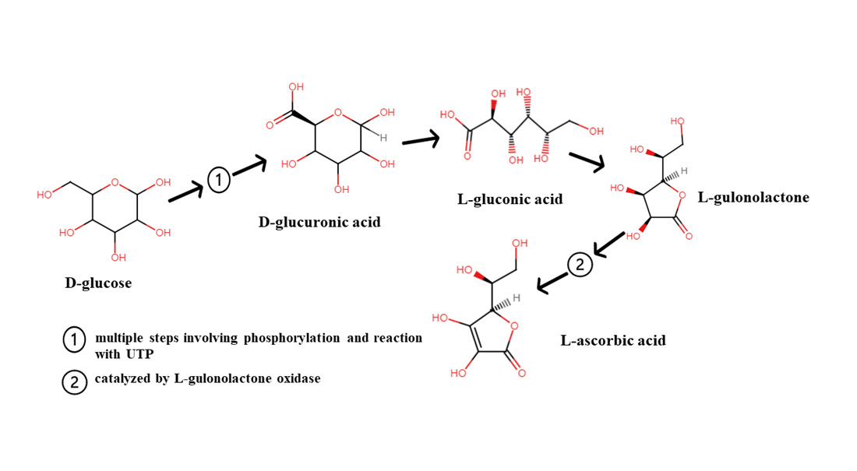
Vitamin C Synthesis and GULO
The synthesis of Vitamin C in mammals from glucose occurs via the glucuronic acid pathway
GULO is the protein that catalyzes the last step in the biosynthesis of Vitamin C
Mammalian species such as primates, some bat species, and guinea pigs are unable to produce Vitamin C, and this is due to a loss of a functional GULO gene that has become a pseudogene
Through sequence comparison of lineages that have a function and non-functional GULO gene, the inactivation dates of GULO have been placed at ~ 61 MYA for primate gene (Lachapelle & Drouin, 2011)
Figure 1: A pathway showing the biosynthesis of ascorbic acid (Vitamin C).
Notes:
Pseudogenes are described as DNA segments that contain a high degree of sequence similarity to functional genes but are non-functional
Through sequence comparison of lineages that have a function and non-functional GULO gene, the inactivation dates of GULO have been placed at 14 and 61 MYA respectively for guinea pig and primate gene

Slide 4
Research Aim
The research focused strongly on identifying predicted key mutations of GULO in the Strepsirrhini sub-order of primates following ancestral sequence reconstruction (ASR)
ASR is the process of estimating protein sequences based on the analysis of modern sequences
Amino acid replacements, particularly those affecting amino acid residues critical for enzyme function, that happened in the internal branch before the pseudogene evolved may have played a significant role in the subsequent loss of functional GULO enzyme activity in the Haplorhini order.
Reveal evolutionary history of the GULO gene by identifying mutaitons responsible for the pseudogenization
Phylogenetic analysis
Notes:
This is because the primates are divided into two suborders: Strepsirrhini and Haplorhini and they are known to have evolved from a common ancestor
Estimated phylogenetic tree using molecular evolution protocols with functional GULO genes from mammalian sequences: from the most-recent common ancestor to the last common ancestor of modern-day primates

Slide 5
Research Methodology – ASR
Sequence Collection (NCBI)
Multiple sequence Alignment
Phylogenetic Tree Construction (RAxML)
Ancestral Sequence Reconstruction (PAML)
Notes:
NCBI

Slide 6
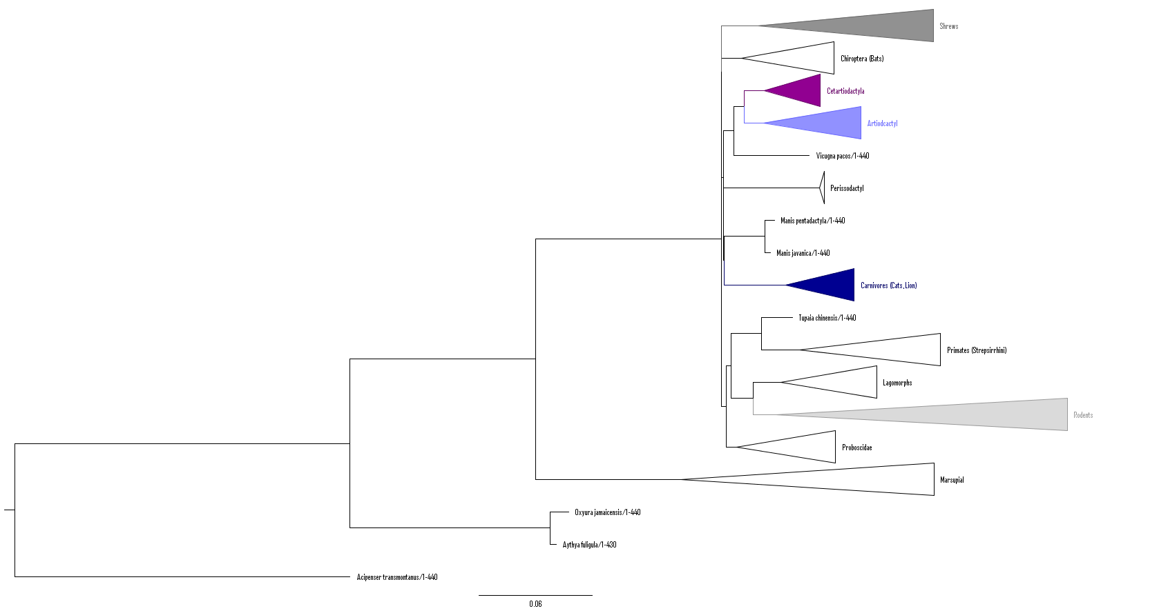


Result
Haplorhini
Figure 2: A collapsed phylogram showing the evolutionary relationship of several mammalian species GULO protein sequences. The tree was prepared using Figtree v1.4.4

Slide 7
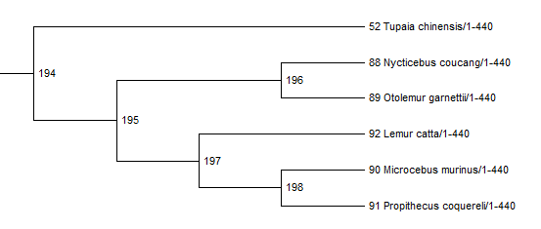

Result
Haplorhini
Figure 3: A section of the phylogram showing the node label for the mammalian species belonging to the Strepsirrhini order. The tree was prepared using Figtree v1.4.4

Slide 8
Result
Table 1: Summary of amino acid changes along nodes 194 to 195 with posterior probabilities
Amino Acid Position | Amino Acid at node 194 | Posterior probability of being replaced | Amino Acid at node 195 | Posterior Probability of being replaced
11 | Glutamine (Q) | 0.995 | Glutamic Acid (E) | 0.993
119 | Alanine (A) | 0.998 | Glycine (G) | 0.998
236 | Asparagine (N) | 0.996 | Serine (S) | 0.995
251 | Isoleucine (I) | 0.991 | Valine (V) | 0.947
283 | Threonine (T) | 0.997 | Asparagine (N) | 0.354
286 | Lysine (K) | 0.991 | Arginine (R) | 0.995
288 | Asparagine (N) | 0.996 | Histidine (H) | 0.996
290 | Asparagine (N) | 0.997 | Aspartic Acid (D) | 0534
337 | Tyrosine (Y) | 0.990 | Phenylalanine (F) | 0.991
433 | Alanine (A) | 0.991 | Serine (S) | 0.988

Slide 9
Conclusion and Future Directions
The relationship between species belonging to the order lagomorphs (Ochotona pirnceps) and rodents (Mus musculus and Rattus Novergicus) is well established showing descent from a common ancestor
The amino acid replacements that have occurred can serve as a starting point to questioning the effect of those changes on the GULO expression since the node is the site of divergence between the Haplorhini and Strepsirrhini species.
Amino acid change can have effects on the structure and function of the protein.
Protein structure and function prediction
Notes:
changes in amino acid properties such as the hydrophobicity and charges can affect protein function, interactivity with other molecules, or enzymatic activity.
Importantly, the population of rodent species is worthy of mention. Perhaps, the representative population in rodents will indicate the success of GULO expression as studies (Ohta & Nishikimi, 1999; Nishikimi et al., 1994) have described the presence of their twelve exons that result in a functional GULO as a basis for comparing the GULO in species such as human that have only six out of the eleven conserved exons responsible for GULO expression.

Slide 10
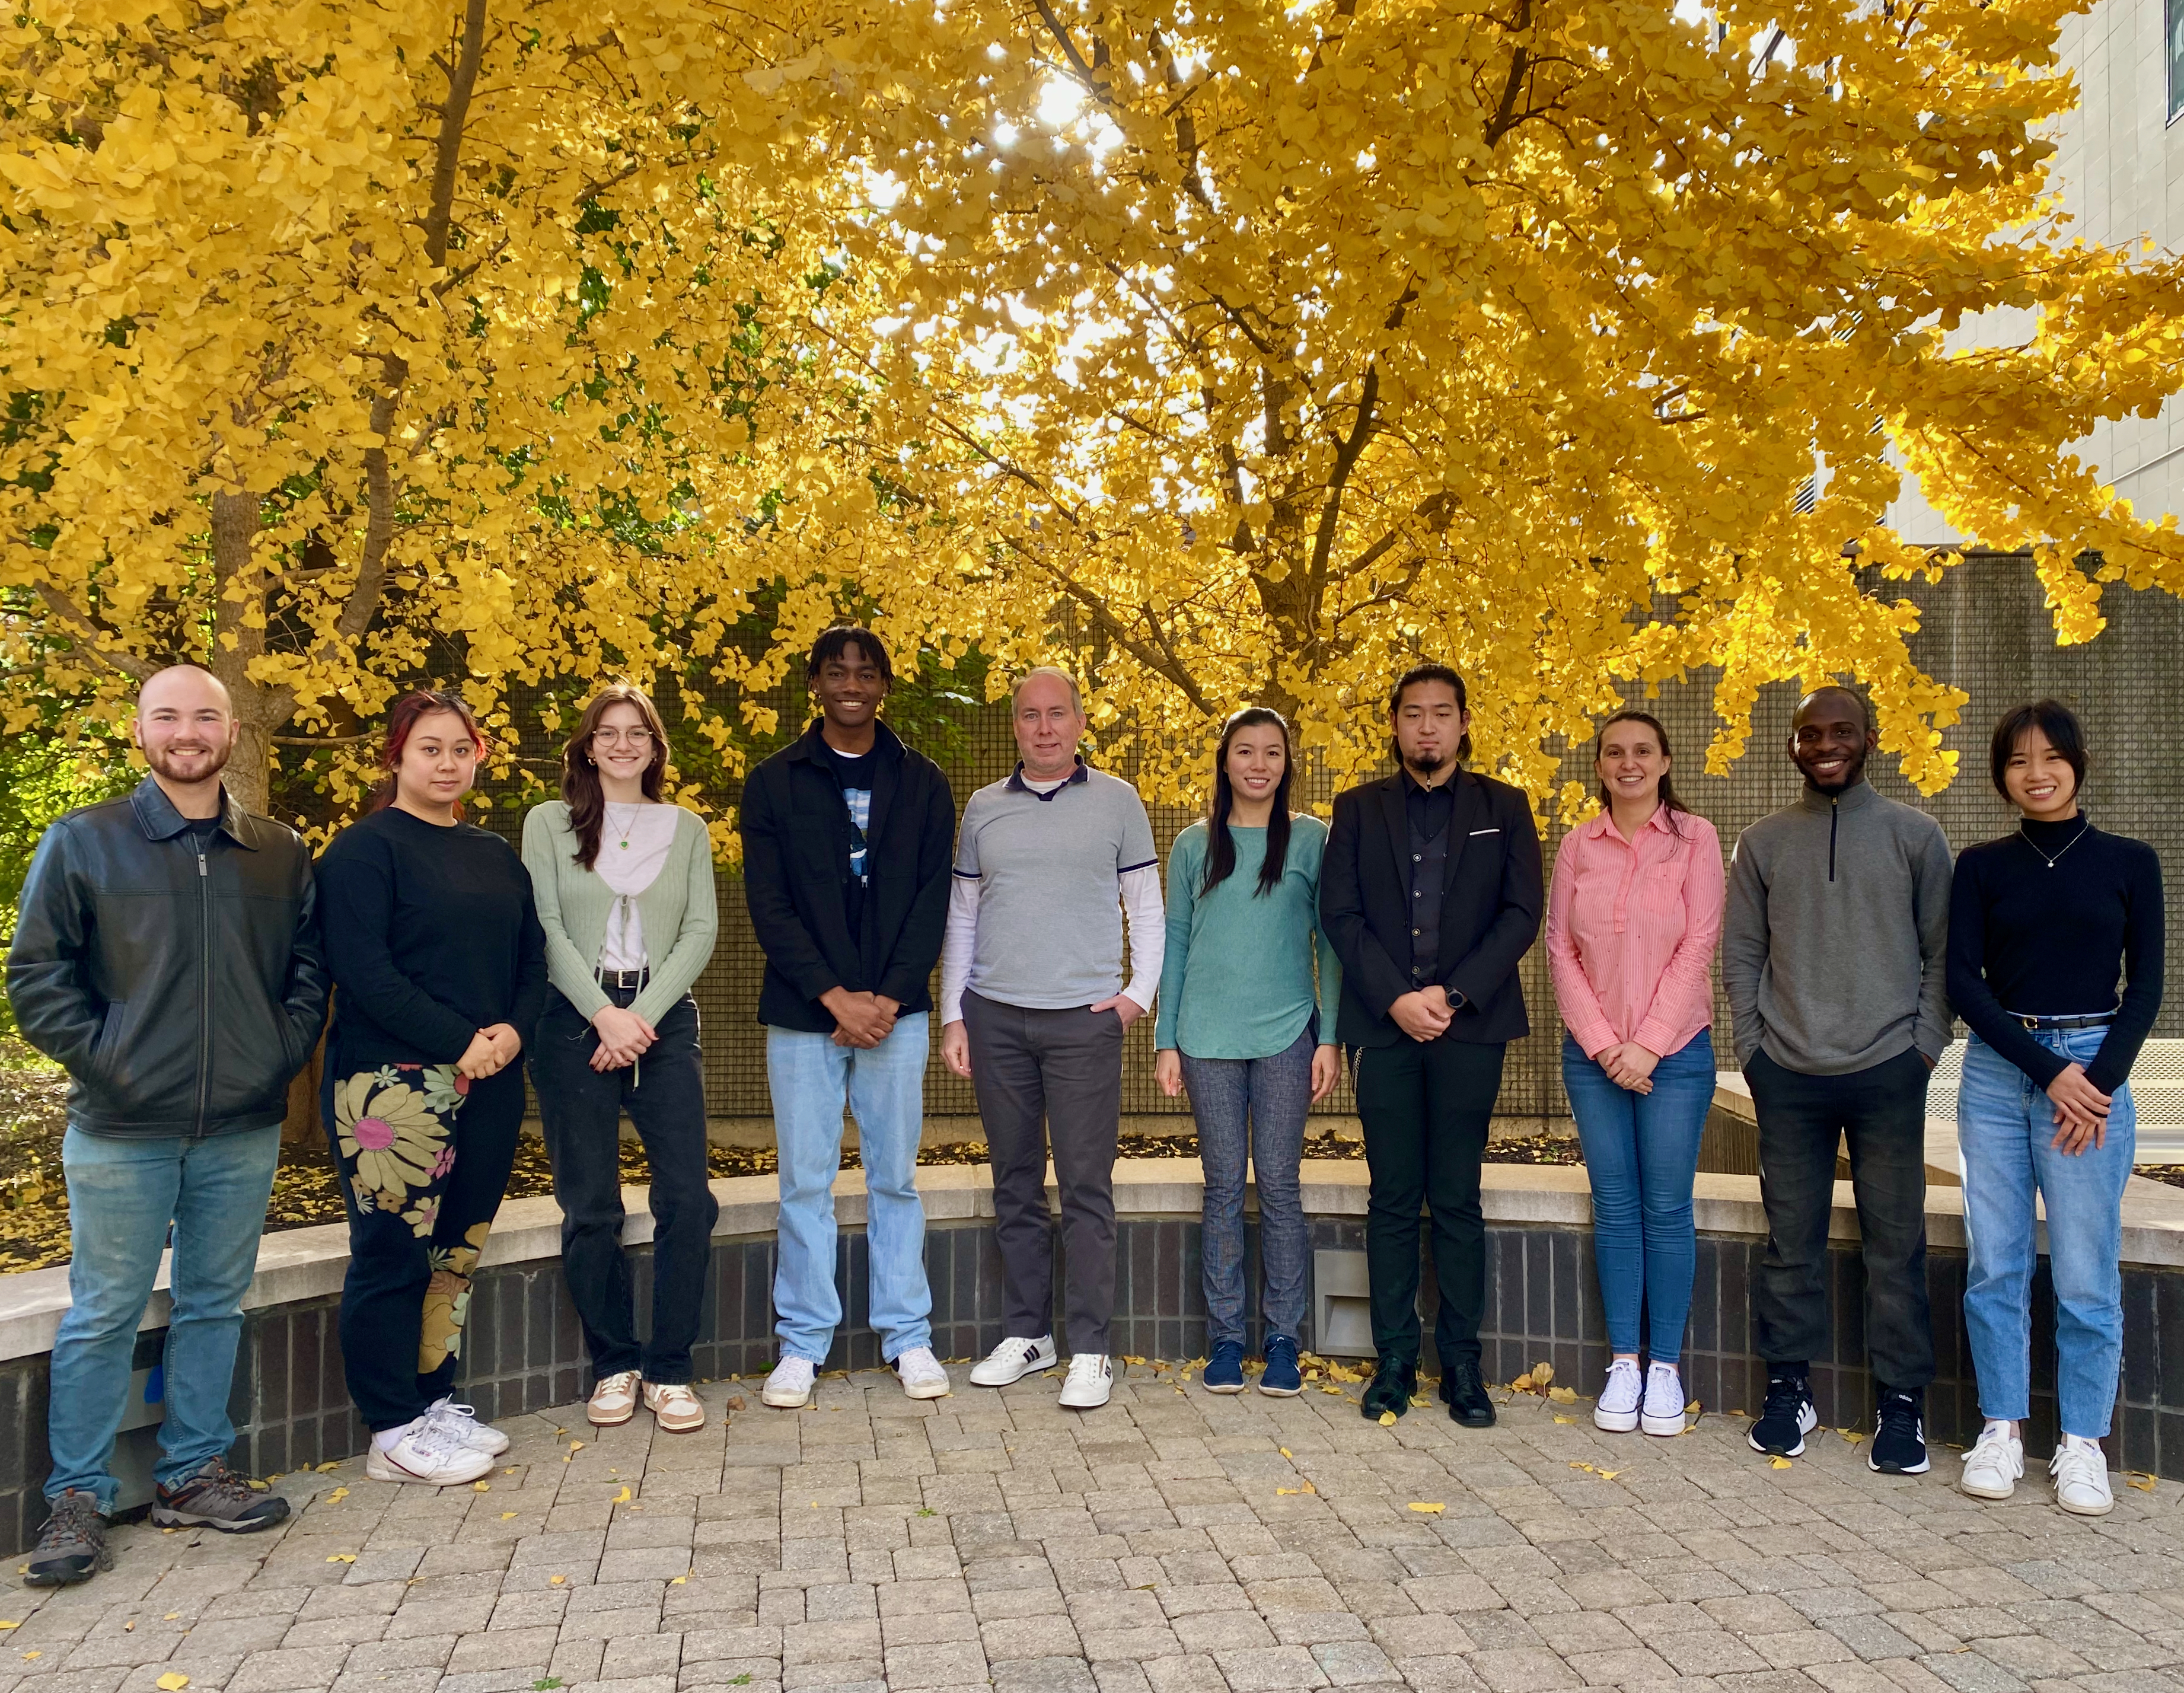
Acknowledgments
Department of Biology

